Slide 1
Inheritance in C++/CLI
IN628 Intermediate Architectures and Algorithms
Semester 2, 2016
Session 8.2
Notes:
So far we haven’t used inheritance.
Inheritance is one of those things that, when people first learn, they tend to want to use for everything.
In fact, inheritance is only one of several choices for extending functionality, and is actually only correct in some very specific cases.
However, our Sprite class is rapidly evolving into one of those cases, so we will discuss it now.
Note that correct inheritance is a very complicated topic and we cover it more in OOSD. Here we only look at the basics.

Slide 2
Inheritance in OO - Review
A group of classes are related in that they have a common core of shared functionality and/or data.
Child classes extend parent (base classes) by descent.
Child classes contain all public or protected data and methods of their ancestors.
Inheritance promotes code reuse and reduces code duplication.
Child classes contain additional data, additional functionality or polymorphic implementations.
The parent-child relationship must be an “is-a” relationship, not a “has-a” relationship.
Notes:
You already know this so we’ll whip through it quickly
We’ll look at the difference between “additional” and “polymorphic in a moment
We’ll talk about is-a and has-a as well.

Slide 3
Inheritance in OO - Review
Inheritance for extension
Base Class: Common Core
Child Class: + Specialised
Notes:
One time we inherit.
The base class is something useful.
But then there is a version of it that adds something specialised
So our sprite class is an animated character. But our player character has, for example, an inventory and inventory management methods, that no other animated character needs.
We might descend “PlayerSprite”, or if we are really planning ahead, “InventorySprite”

Slide 4
Inheritance in OO - Review
Inheritance for polymorphism
Base Class – Common Core
Including ImportantJob
Child Class1
Implements ImportantJob with algorithm 1
Child Class2
Implements ImportantJob with algorithm 2
Notes:
One time we inherit.
The base class is something useful.
All elements of this class must do important job
But there are multiple logically distinct ways to do this important job.
So you descend multiple children. Each exposes the identical function prototype, but the code bodies are different.
At runtime, you create an instance of the child class. When ImportantJob is called, the system executes the corresponding code version.
So we started our sprite class with simple vectorised movement. Then we saw that some sprites need directional movement (players, NPCS) and other sprites need trajectory-based movement (projectiles). So we might choose to descend two classes from sprite. Directional and Trajectory.
Then PlayerSprite/InventorySprite would descend from Directional. Or you might go Sprite->Inventory->Player.
At this point you can see one of the risks associated with inheritance – cumbersome heirarchies.
Can you think of a way to implement this directional/trajectory distinction without inheritance?
State variables and a switch in the move method.
This would allow you to have a player character who could also jump
Some might mention interfaces. Also a possibility.

Slide 5
Dangers of Inheritance
Cumbersome hierarchies – confusing to use
Single hierarchical structure not a good match for information architecture.
Hidden functionality in ancestors
Notes:
You can very quickly find yourself needing 100s of classes to make all the feature sets you need. Dependency injection (strategy pattern) is a better solution here (cf. OOSD).
Especially in the absence of multiple inheritance it can get awkward.
E.G. We really want our player character to descend from DirectionalSprite and InventorySprite to combine the features of the two.
For linguistic reasons (specifically, potential ambiguity) most modern languages don’t allow this.
Interfaces are your friend here (cf. OOSD).
Hidden functionality is the worst one. You can’t see what the child can do just by looking at its .h file. The deeper your hierarchy, the worse it gets.

Slide 6
Don’t Use Inheritance....
...when it isn’t a true “is-a” relationship
Notes:
Discuss implementing Conway by descending from DataGridView
Aggregation/Composition is the preferred technique here.

Slide 7
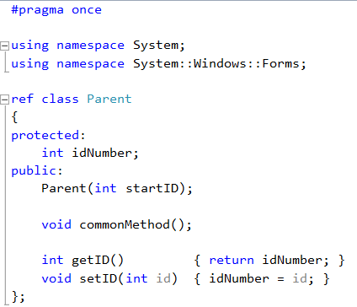
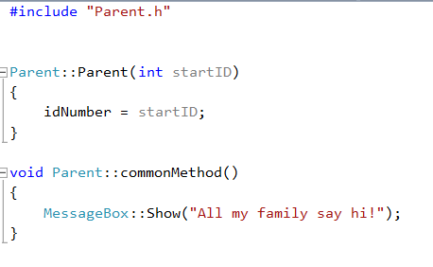
Inheritance Syntax in C++/CLI
Notes:
Assume this class, with .h on the left and .cpp on the right.
We are going to descend from it.
What will the children have?
An int idNumber with set and get methods
A method commonMethod as shown

Slide 8

Inheritance Syntax in C++/CLI
In Child1.h
Notes:
The first inheritance use case – a child needs additional functionality
Descend with :public and the name of the base class
This is equivalent to the extends keyword in Java
There is private inheritance as well, but it is out of scope for us.
Make sure to include the parent’s .h file to put the parent type in scope
If you fill in the base class box in the class creation wizard, it does this bit for you

Slide 9
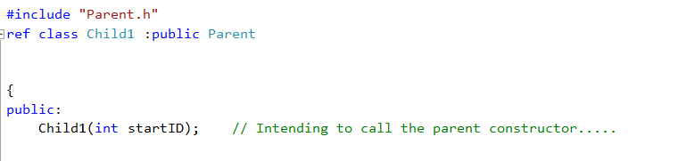
Inheritance Syntax in C++/CLI
In Child1.h
If you want to call the parent constructor, make sure the child constructor contains at least all the input arguments that the parent constructor contains.
Notes:
In the parent constructor, we initialise the common data values and perform other common initialisation
You only want to write this code once, so you put it in the parent class and let the child call the parent constructor.
This is just a normal function call, so you must pass the required arguments to that call.
The rule is:

Slide 10
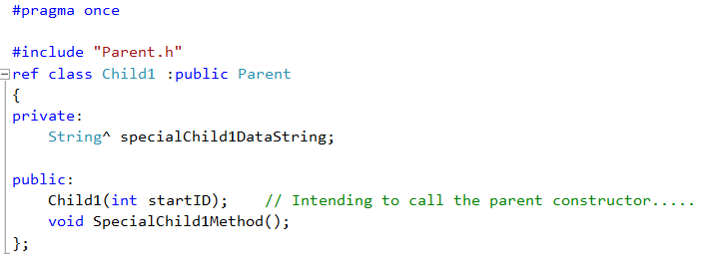
Inheritance Syntax in C++/CLI
In Child1.h
Notes:
Then child1 can have whatever additional data and methods it needs
In the .cpp these work exactly as they do for any non-child class.
Only the constructor is different....

Slide 11
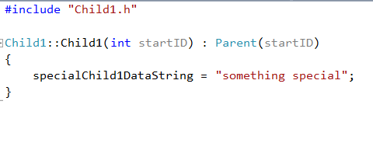
Inheritance Syntax in C++/CLI
In Child1.cpp
Notes:
Note the syntax for the call to the parent
: after the child arg list
Give the parent class’s name. Some languages just say “base”. This is not one of them.
This is a function call. It needs arguments. In this case, just pass the input arg to the child along. NO DATA TYPE.
Don’t become confused. Even though this call is in the prototype line, it is not a prototype or part of the prototype. IT IS A FUNCTION CALL.
In the code body, do whatever you want.
What is the state of the instance after this constructor? => both specialCihldDataString and idNumber are initialised.

Slide 12
Inheritance Syntax in C++/CLI
Overriding
virtual
The parent provides a default code body (may be empty)
Children have the option of overriding with their own code, or using the parent’s default version
abstract
The parent provides no code body
All children must provide their own code
Instances of the parent class cannot be instantiated.
Notes:
The second inheritance use case – polymorphism
The parent provides a method (with or without default code body) and children can (or must) override the method, providing their own code.
Abstract is safer (each class guaranteed to have the right logic), virtual is more convenient (you can provide a default method).
If there is any sensible default, one tends to go virtual, especially because there is an alternative to abstract classes (interfaces; cf. OOSD)

Slide 13
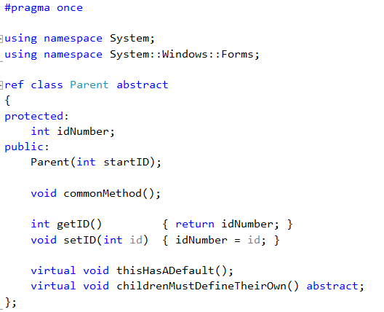
Inheritance Syntax in C++/CLI
Notes:
The syntax is a little odd. Just go with it.

Slide 14
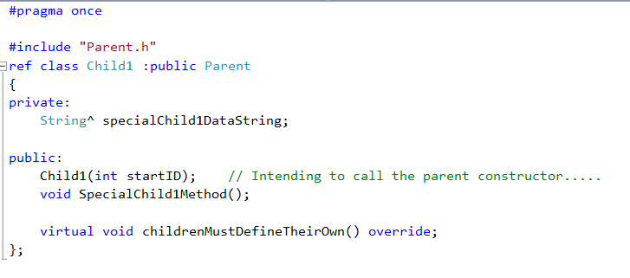
Inheritance Syntax in C++/CLI
In Child1.h
Notes:
When the child overrides, they mark it in the .h. This just tells the compiler you really mean it

Slide 15
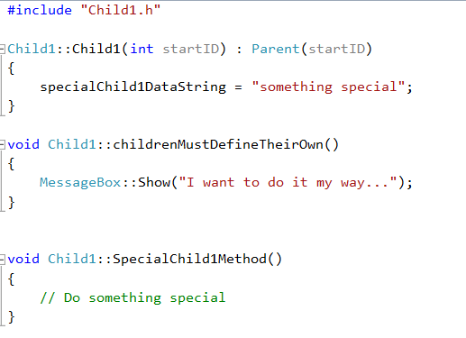
Inheritance Syntax in C++/CLI
In Child1.cpp
Notes:
IN the .cpp, it just looks normal. No virtual or override keywords
Other languages have different rules for how virtual, abstract and override are marked. You really have to look it up every time you switch languages. But the logic is always the same.

Slide 16
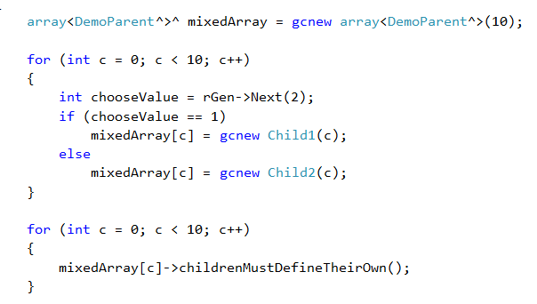
Inheritance Syntax in C++/CLI
Notes:
Just a reminder of the big benefit of inheritance beyond the tidiness of the architecture (when it’s done right)...
NB: Changed class to DemoParent here because Parent is actually a C++/CLI keyword, so it shouldn’t be used to classes you intend to actually use.

Slide 17

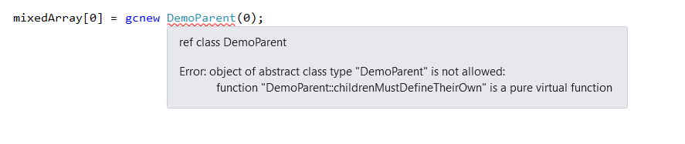
Inheritance Syntax in C++/CLI
Notes:
Comprehension check: What is the compiler mad about?

Slide 18
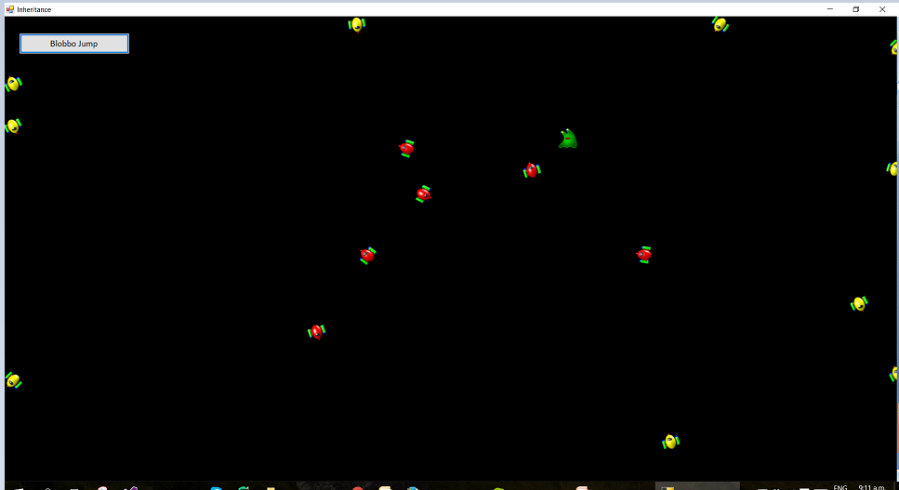
Practical
Approach-Avoid
Notes:
This program has three classes:
SimpleSprite is the base class. It is a simple sprite implementation without directional movement or bounds actions.
Approacher and Avoider are children or SimpleSprite. They polymorphically implement the method orient(target).
Approachers aim themselves at the target; Avoiders aim themselves away from the target.
We create one SimpleSprite instance – that’s Blobbo
We create a linked list of SimpleSprites, containing a mixture of Approachers and Avoiders. As discussed, a variable of type Parent can be instantiated as a variable of any Child type (just as if you ask for a mammal, you can receive either a cat or a dog).
In the timer, all elements in the list are treated the same – their orient and move methods are called. The polymorphic version of orient belonging to each child will be executed, and Approachers will follow the target while Avoiders will run away.

Slide 19
Practical
Use Inheritance Approach Avoid Skeleton
Carefully study the existing classes, SimpleSprite, SpriteList and Form1. Read the comments in Form1.h
Add two new classes Approacher and Avoider, both descended from SimpleSprite, so that your application runs as in the demo.
Before creating your new child classes, decide:
What data members and methods do they inherit from their parent?
What additional data members (if any) do they each need?
What additional methods (if any) do they each need?
What inherited methods (if any) do they each need to override?
If you are going to add methods or override inherited methods, what is the logic for each one?
Notes:
If you name your child classes Approacher and Avoider, everything else that is required -- Include statements, Form event handler code, etc. – is already provided.
You should not need to modify any of the existing code, only add your new classes.
It would be good technique to actually write out the answers to these questions before you create the new classes...

